Slide 1
Lung Cancer Early Detection System for Non-Smokers Using Machine Learning
GitHub: github.com/hemu-08/lung-cancer-detection
Project done by: Pallapothu Hemanya Sai

Slide 2

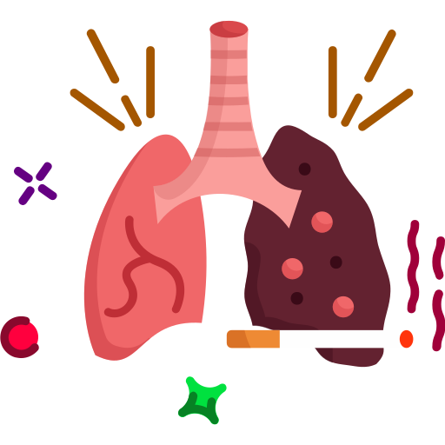


Problem Statement & Motivation
Why Early Detection of Lung Cancer in Non-Smokers Needs a New Approach ?
Current Problem:
Lung cancer in never-smokers is rising
Often diagnosed late due to non-specific symptoms
Existing screening tools don’t target non-smokers
Lack of early, personalized detection methods
Why This Matters
Clinical notes contains unnoticed early clues
Clinical symptoms contain hidden early risk patterns
ML models can detect patterns faster than manual screening
Early detection = better survival, less invasive treatment
Our Direction
Machine Learning
Clinical Symptoms
Clinical Notes
Explainable Early Detection

Slide 3
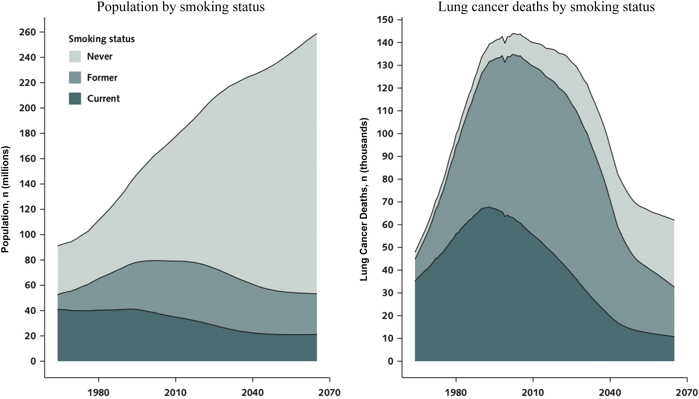
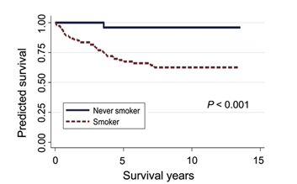
Project Objectives
Enable early detection of lung cancer in never-smokers.
Map clinical symptoms to relevant lung cancer genes.
Build interpretable and explainable AI models.
Integrate clinical notes and clinical symptom data for prediction.
Automate the workflow using machine learning (Random Forest) tools.
Source: Journal of Thoracic Oncology 2022

Slide 4
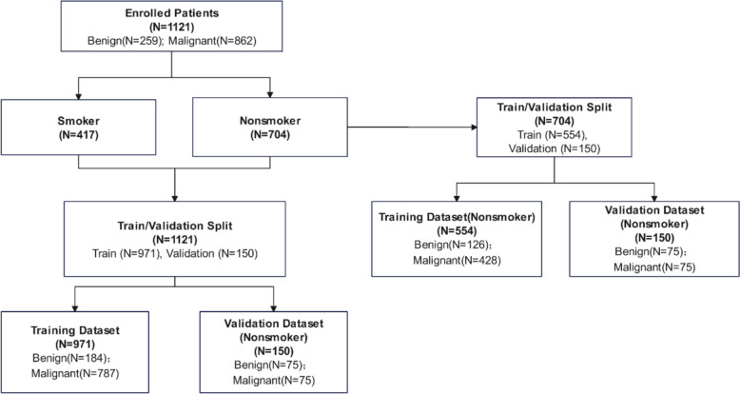
Base Paper
"An early lung cancer diagnosis model for non-smokers incorporating CT imaging analysis and circulating genetically abnormal cells (CACs)"
https://pubmed.ncbi.nlm.nih.gov/39844169/
Built AI models using CT imaging + liquid biopsy + clinical features for non-smokers.
Achieved AUC = 0.99, sensitivity 92%, specificity 97%.
Limitation: Does not use unstructured clinical notes or agentic AI for explainability.
Our Difference
We integrate clinical notes + genomic profiles (not CT/biopsy).
Use agentic AI + knowledge graphs for explainable predictions.
Focus on symptom–gene mapping and patient journey interpretation.

Slide 5
Dataset Description
This dataset was synthesized for early detection of lung cancer using Python (pandas, numpy, scikit-learn) with realistic clinical symptom distributions.
Total records: 3000 (1500 cancer, 1500 non-cancer)
Model trained: Random Forest Classifier — 84% Accuracy
Key Columns:
visit_date – Date and time of hospital/clinic visit.
SMOKING – Smoking history indicator (0 = non-smoker, higher = severity).
YELLOW_FINGERS – Clinical sign often associated with nicotine usage.
ANXIETY – Psychological state measurement.
PEER_PRESSURE – Social influence contributing to lifestyle habits.
CHRONIC DISEASE – Presence of long-term illness or comorbidity.
FATIGUE – Level of tiredness and physical weakness.
ALLERGY – Indication of respiratory or other allergic conditions.
WHEEZING – Sound indicating narrowed or obstructed airways
LUNG_CANCER – Target label (YES/NO diagnosis).

Slide 6
Clinical Notes Example
Patient 1 Note:
“This patient, an 78-year-old female never-smoker, presents with symptoms consistent with advanced lung cancer including yellow fingers, anxiety, fatigue, wheezing, coughing, shortness of breath, chest pain, and swallowing difficulty. Her symptoms have worsened over the past few days. Symptoms: paraneoplastic syndrome (since 10 weeks), night sweats (since 4 years), SVC syndrome (since 5 weeks), chest pain (since 2 years), shoulder pain (since 3 years), peripheral edema (since 11 months), shortness of breath (since 5 months).”
Key Clinical Insights – 78-year-old Female, Never-Smoker:
Yellow fingers + anxiety + fatigue → systemic/psychological impact
Respiratory symptoms → wheezing, cough, dyspnea, chest pain, dysphagia
Paraneoplastic syndrome (10 weeks) → strong cancer association
SVC syndrome (5 weeks) → mediastinal tumor compression
Night sweats (4 years) → chronic systemic symptom, possible malignancy marker
Chest pain (2 years) → local tumor/pleural involvement
Shoulder pain (3 years) → possible Pancoast tumor involvement
Peripheral edema (11 months) → venous/lymphatic obstruction
Shortness of breath (5 months) → progressive respiratory compromise
Confirmed advanced lung cancer ✅
Takeaway: Combination of paraneoplastic features, vascular compression (SVC syndrome, edema), systemic red flags (night sweats, weight loss, fatigue), and chronic pain (chest, shoulder) → points to advanced lung cancer with multi-system involvement, despite patient being a never-smoker.

Slide 7
Model Architecture
Dataset Collection
Agent 1: Symptom & Timeline Extractor
Agent 2:
Gene Matcher
Agent 3:
Causal Inference Reasoning
Risk Scoring
Agent 4:
Personalized Risk Calibration
Agent 2:
Gene Matcher
Agent 1: Symptom & Timeline Extractor
Agent 2: Gene Matcher (Knowledge Graph-Based)
Tools: Python + Flask + Scikit-learn
Current Implementation: Random Forest Classifier — 84% Accuracy (Phase 2)
Input: Clinical notes from multiple patient visits
Output: Extracted symptoms with timestamp metadata
Builds a Patient Journey Graph showing symptom evolution over time
Uses a Lung Cancer Knowledge Graph (e.g., gene–symptom–disease relationships from DisGeNET, UMLS, etc.)
Maps extracted symptoms to relevant lung cancer-associated genes.
Captures multi-hop biological relationships (e.g., Symptom → Disease → Gene)

Slide 8
Model Architecture
Dataset Collection
Agent 1: Symptom & Timeline Extractor
Agent 2:
Gene Matcher
Agent 3:
Causal Inference Reasoning
Risk Scoring
Agent 4:
Personalized Risk Calibration
Agent 2:
Gene Matcher
Agent 3: Causal Inference Reasoning Agent
Agent 4: Personalized Risk Calibration Agent
Tools: Python + DoWhy / CausalNex + NetworkX
Input:
Mapped symptom–gene associations from Agent 2
Patient demographics (age, gender)
Environmental exposure factors (air pollution, radon, occupation)
Output:
Causal-weighted gene risk factors
Confounder-adjusted causal effect scores
Causal explanation graphs
Tools: Python + Bayesian Modeling + Calibration Techniques (Platt Scaling / Isotonic Regression)
Input:
Raw lung cancer risk score
Causal-weighted outputs from Agent 4
Patient demographic and population-level attributes
Output:
Personalized, calibrated lung cancer risk score
Population-aware screening thresholds
Bias-adjusted risk interpretation

Slide 9
METHODOLOGY
METHODOLOGY:Dataset Generation & Feature Engineering
Dataset Generation:
3000 synthetic patient records generated using Python (pandas, numpy).
1500 cancer patients + 1500 non-cancer — balanced dataset.
Realistic symptom distributions — cancer patients have higher symptom weights.
Features Used (8 clinical symptoms):
SMOKING, YELLOW_FINGERS, ANXIETY, PEER_PRESSURE
CHRONIC_DISEASE, FATIGUE, ALLERGY, WHEEZING
Tools & Libraries:
Python, pandas, numpy, scikit-learn

Slide 10
METHODOLOGY
Model Training:
Algorithm: Random Forest Classifier (100 decision trees)
Train/Test Split: 80% training, 20% testing
Model Accuracy: 84% on test data
Model saved as model.pkl using Python pickle library
Why Random Forest:
Handles both binary and multi-class features well
Resistant to overfitting — good for medical data
Provides probability scores — not just YES/NO predictions
Aspect | Improvement
Clinical trust | Very high
False positives | Reduced
Scientific rigor | Strong
Publication value | Excellent

Slide 11
METHODOLOGY
METHODOLOGY: Flask Web Application & API
Backend — Flask REST API:
POST /predict — accepts 8 symptom inputs as JSON
Loads model.pkl and runs prediction in real time
Returns result: HIGH RISK or LOW RISK + probability percentage
Frontend — HTML/CSS/JavaScript:
8 dropdown inputs for clinical symptoms
Real-time result display with color-coded risk indicator
Green = LOW RISK, Red = HIGH RISK with probability score

Slide 12
METHODOLOGY
Results & Outcomes:
Model Accuracy: 84% on 600 test samples
Macro average precision: 85%, recall: 84%
Live web app successfully predicts HIGH/LOW RISK in real time
Example Predictions:
Non-smoker, no symptoms → LOW RISK (Probability: 2.49%)
Multiple symptoms present → HIGH RISK (Probability: 99.33%)
Tech Stack Used:
Python, scikit-learn, Flask, HTML/CSS/JavaScript
GitHub: github.com/hemu-08/lung-cancer-detection

Slide 13
Key References
[1] Chen, C.-Y., Kuo-Yen, & Yang, P.-C. (2024). The role of PM2.5 exposure in lung cancer: mechanisms, genetic factors, and clinical implications. EMBO Molecular Medicine. https://www.embopress.org/doi/full/10.1038/s44321-024-00175-2
[2] Chiu, C.-H., & Yang, P.-C. (2024). Challenges of lung cancer control in Asia. The Lancet eClinicalMedicine, 72, Article 102942. https://www.thelancet.com/journals/eclinm/article/PIIS2589-5370(24)00285-2/fulltext
[3] Zheng, H., Zhang, Q., Gong, Y., Liu, Z., & Chen, S. (2024). Identification of prognostic biomarkers for stage III non-small cell lung carcinoma in female nonsmokers using machine learning. In 2024 10th International Conference on Biomedical Engineering and Informatics (BMEI). https://ieeexplore.ieee.org/abstract/document/10762221
[4] Hendriks, L. E. L., Remon, J., Faivre-Finn, C., Garassino, M. C., Heymach, J. V., Kerr, K. M., Tan, D. S. W., Veronesi, G., & Reck, M. (2024). Non-small-cell lung cancer. Nature Reviews Disease Primers, 10, Article 43.

Slide 14
[5] Buana, I., Soeroso, N. N., Tarigan, S. P., & Syahruddin, E. (2022). Risk factors for lung cancer in non-smoking women, North Sumatera, Indonesia. Sumatera Medical Journal, 8(1), 28–34. https://doi.org/10.32734/sumej.v8i1.18763
[6] Győrffy, B. (2024). Transcriptome-level discovery of survival-associated biomarkers and therapy targets in non-small-cell lung cancer. British Journal of Pharmacology, 181(5), 1007–1022.
[7]Lam, S. (2025). Lung cancer screening in never-smokers. Current Opinion in Oncology, 37(1), 54–58. https://journals.lww.com/co-oncology/abstract/2025/01000/lung_cancer_screening_in_never_smokers.13.aspx
[8]Kang, H.-R., Cho, J. Y., Lee, S. H., Lee, Y. J., Park, J. S., Cho, Y.-J., Yoon, H. I., Lee, K. W., Lee, J. H., & Lee, C.-T. (2019). Role of low-dose computerized tomography in lung cancer screening among never-smokers. Journal of Thoracic Oncology, 14(10), 1649–1657.

Slide 15
[9] Kerpel-Fronius, A., Tammemägi, M., Cavic, M., Henschke, C., Jiang, L., Kazerooni, E., Lee, C.-T., Ventura, L., Yang, D., Lam, S., Huber, R. M., et al. (2022). Screening for lung cancer in individuals who never smoked: An International Association for the Study of Lung Cancer Early Detection and Screening Committee report. Journal of Thoracic Oncology, 17(2), 188–205. https://www.sciencedirect.com/science/article/pii/S1556086421023911
[10] Wang, P., Sun, S., Lam, S., & Lockwood, W. W. (2023). New insights into the biology and development of lung cancer in never smokers—Implications for early detection and treatment. Journal of Translational Medicine, 21(1), Article 484.

Slide 16
THANK YOU

